Slide 1
Wizard Session Attachments
They never said They were a MIME

Slide 2
Agenda
Multi Part Bodies
Attachments Ye Olde Way
OnMultipartSend
Graph API
Putting It All Together

Slide 3
MIME
Multipurpose Internet Mail Extensions
Email
How do we put more than one thing in a text document?
Studio Mediation Context
Parts[0]
Content-Type
Multipart/form-data

Slide 4
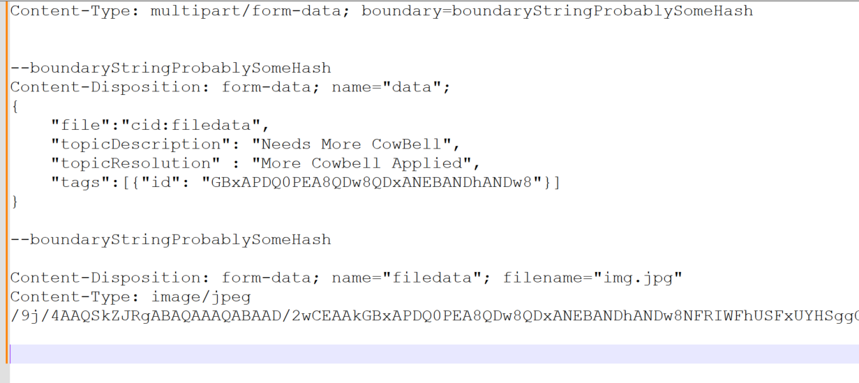
What does it look like?

Slide 5
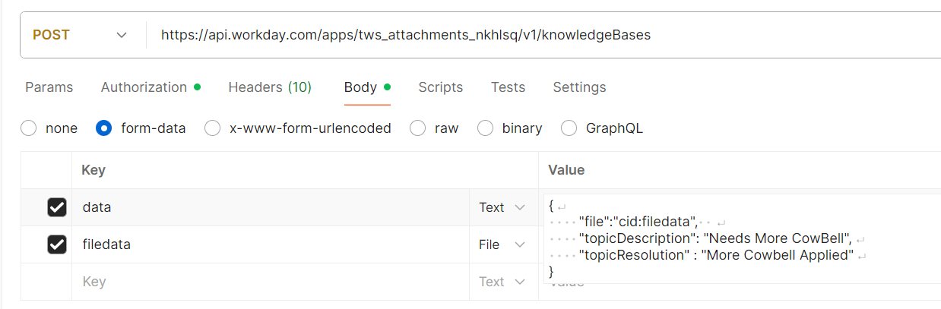
What does it look like?

Slide 6
Ye Olde School

Slide 7
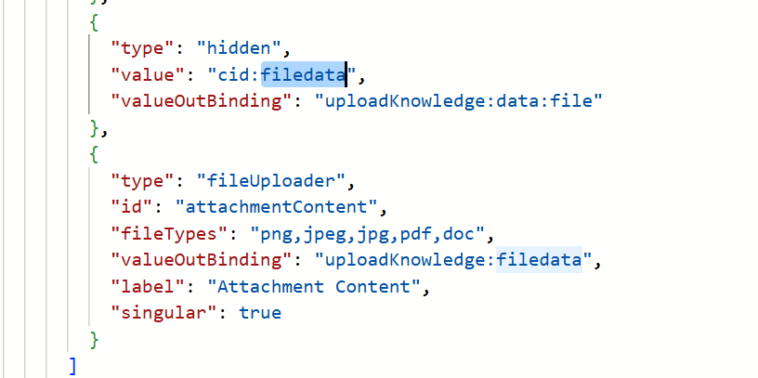
We do it ourselves

Slide 8
Graph API

Slide 9
Why Graph?
Exception
Cleaner Interface
Build with CoPilot

Slide 10
CoPilot

Slide 11
onMultiPartSend

Slide 12
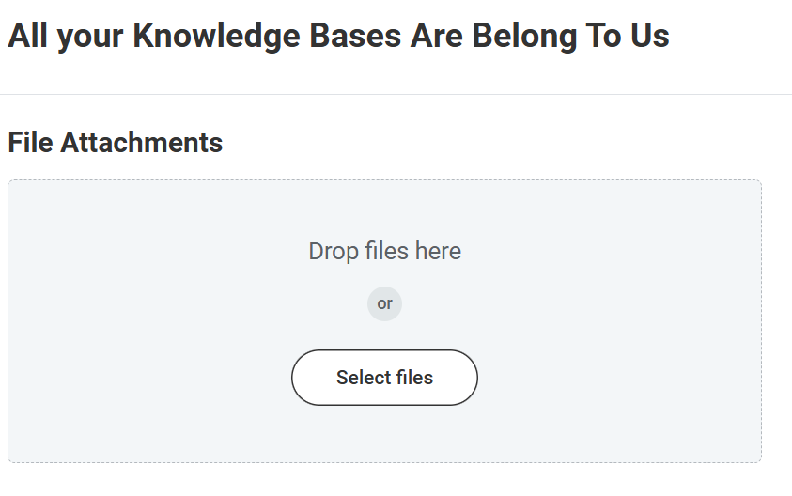
Templates
Templates feel backwards for most users
Keeps the file and the metadata together
Grid indexes can get out of sync
It’s a Map

Slide 13
Flow
Build the fileUploader
Build the template
Build the metadata
THEN!
Build the onMultipartSend

Slide 14
onMultipartSend
Loop through each file
Find the template
Put the metadata values into the JSON

Slide 15
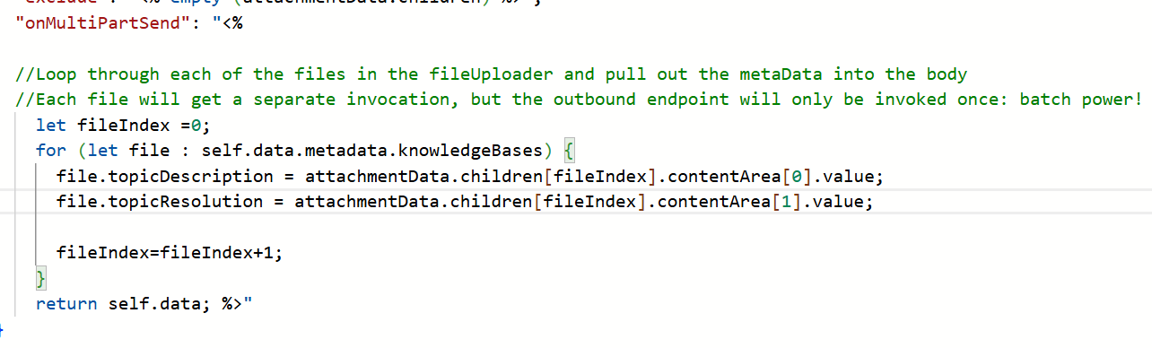
onMultipartSend

